Slide 1
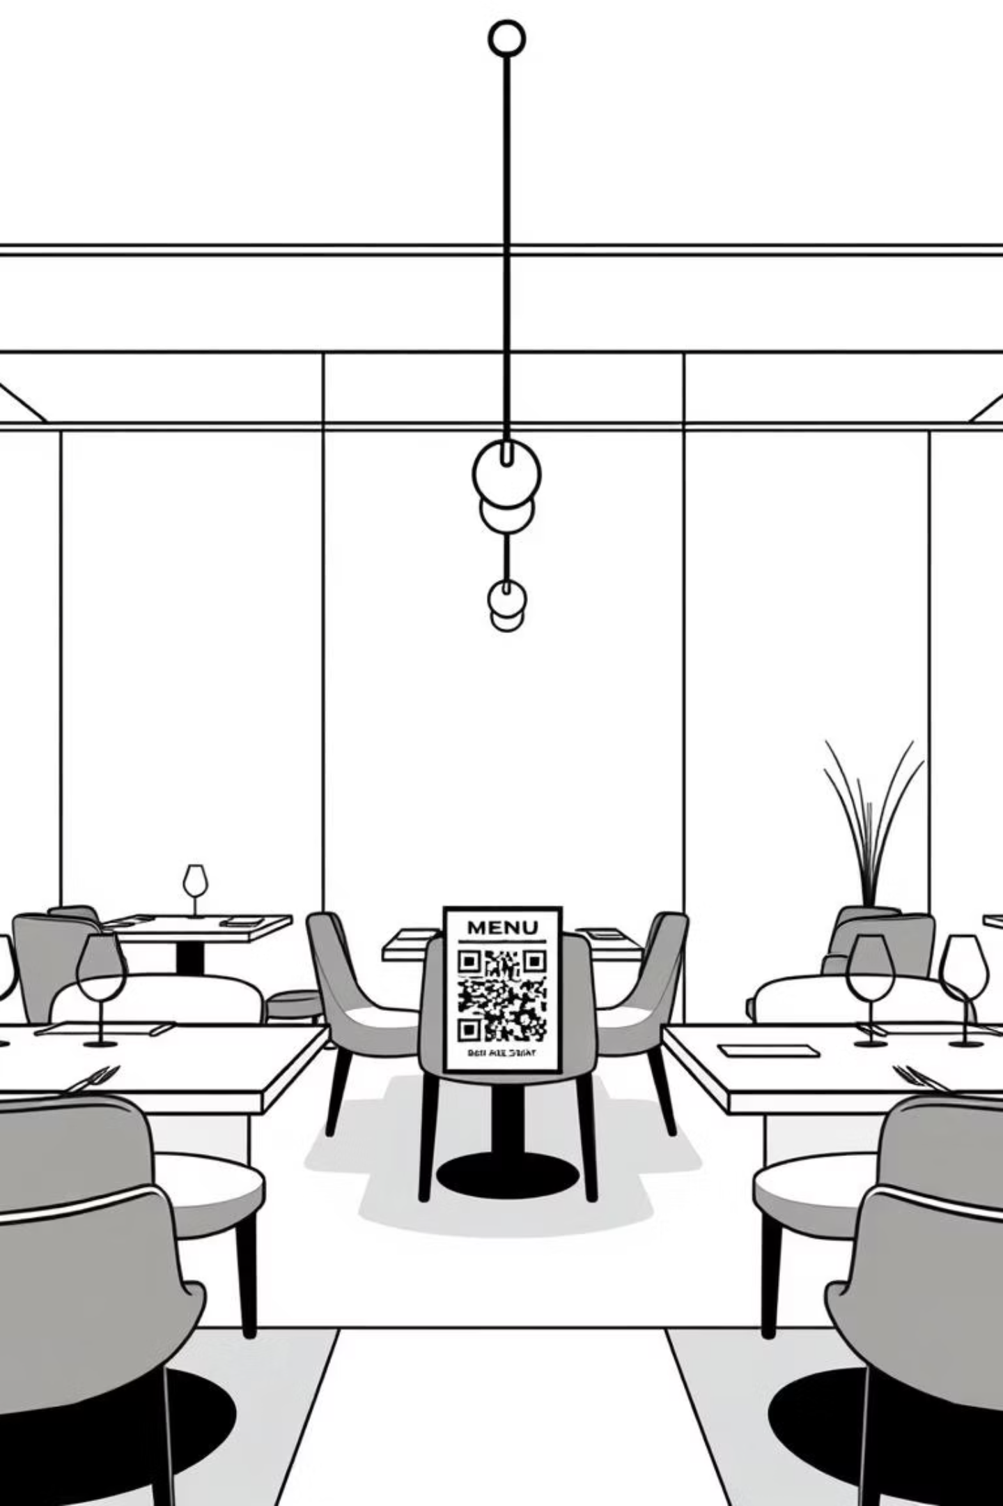
The Butler: The Digital Dining Experience
Revolutionising Restaurant & Hotel Operations

Slide 2


The Problem: Old Ways Lead to Lost Opportunities
Slow Service
Limited Insights
Manual processes bottleneck staff, frustrating customers with long waits for menus, orders, or the bill.
Owners lack real-time data on sales, popular items, and staff performance, hindering informed decision-making.
Customer Disconnect
Static menus and impersonal service prevent upselling and gathering valuable feedback.

Slide 3
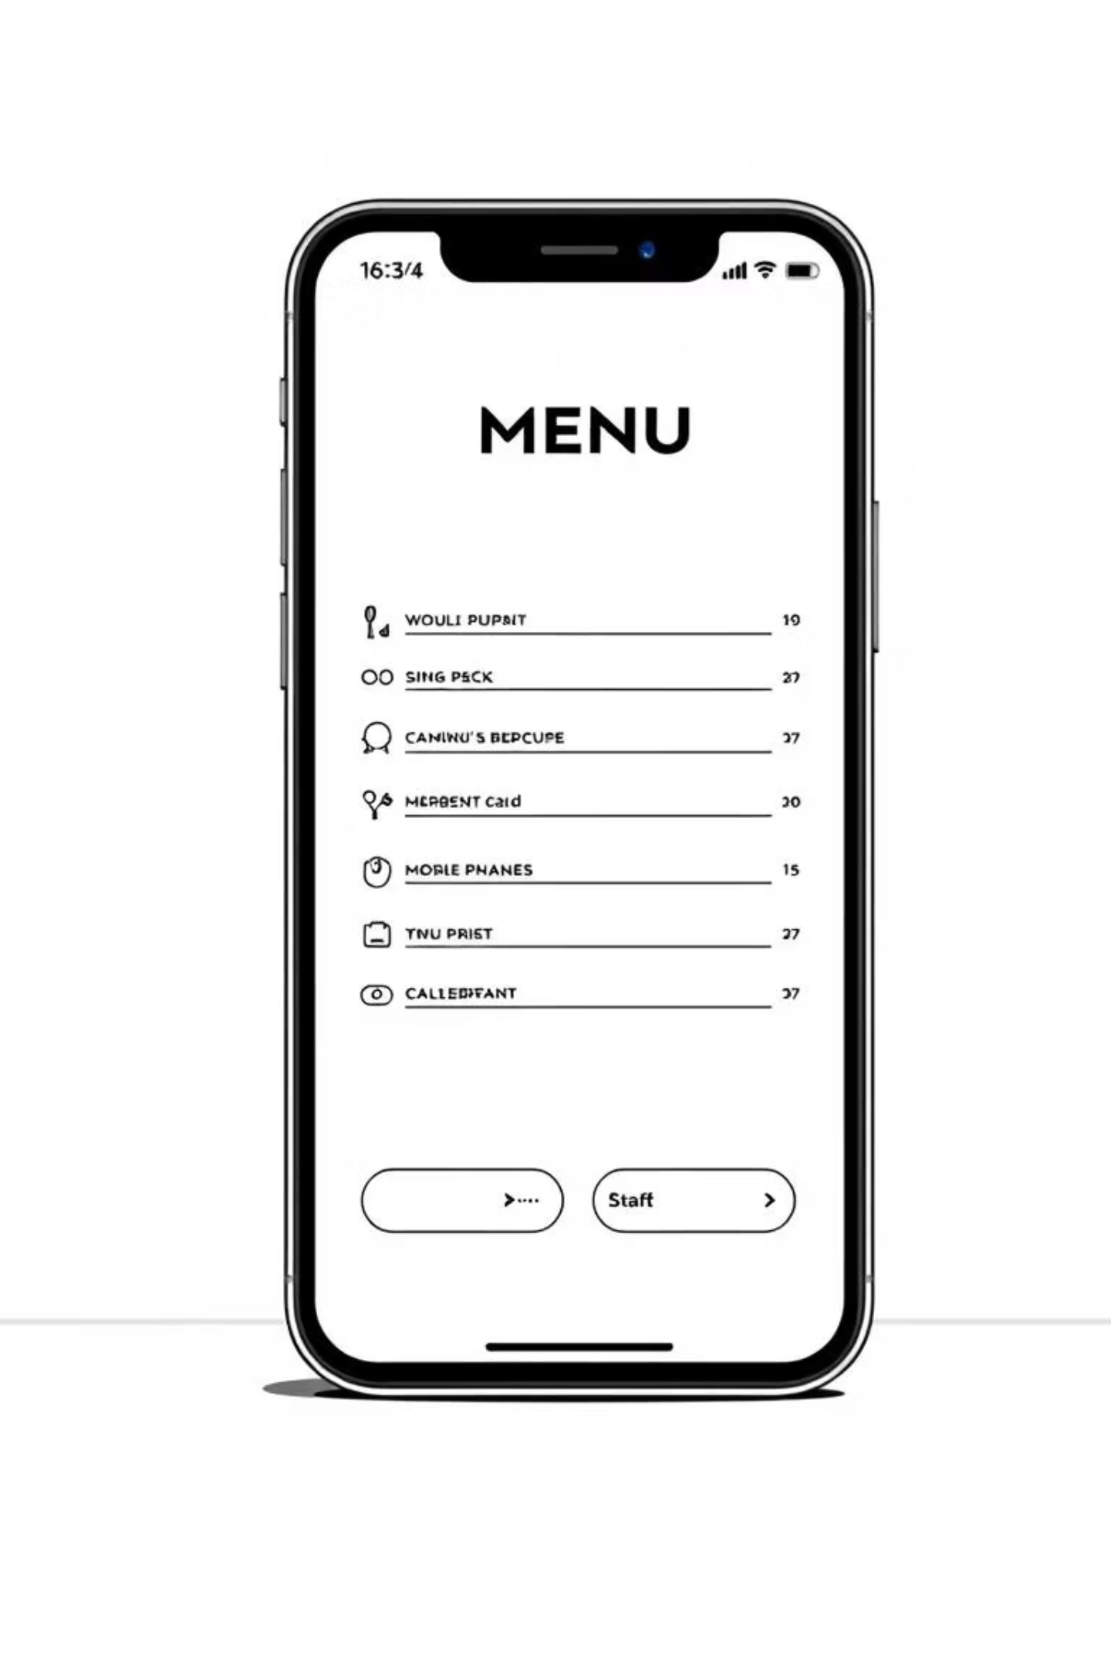



Our Solution: Seamless Digital Interaction
SmartServe provides a comprehensive digital platform connecting customers, staff, and management.
Customer QR Interface
Instant access to menus and services via mobile web app.
Staff Workplace Dashboard
Real-time order and request management for efficient operations.
Owner Analytics Dashboard
Actionable insights for business growth and optimisation.

Slide 4

Market Fit & Demand: The Digital Shift
The hospitality industry is rapidly adopting digital solutions to meet evolving customer expectations and operational demands.
Growing Demand for Convenience
Operational Efficiency is Key
Customers expect instant access and self-service options, mirroring trends in other industries.
Businesses seek tools to reduce labour costs and improve service speed.
Automated order processing
Mobile-first generation
Reduced human error
Contactless preferences

Slide 5





The Butler: Key Features
Dynamic Digital Menus
Direct Ordering & Service Requests
Integrated Payments
Interactive menus with images, descriptions, and allergen info, updated in real-time.
Secure, split-bill payment options directly from the table, streamlining checkout.
Customers order food, call staff, or request room service directly from their device.
Real-Time Analytics
Role-Based Dashboards
Owners gain insights into sales, popular items, peak hours, and staff performance.
Tailored interfaces for kitchen, housekeeping, and floor managers, enhancing workflow.

Slide 6
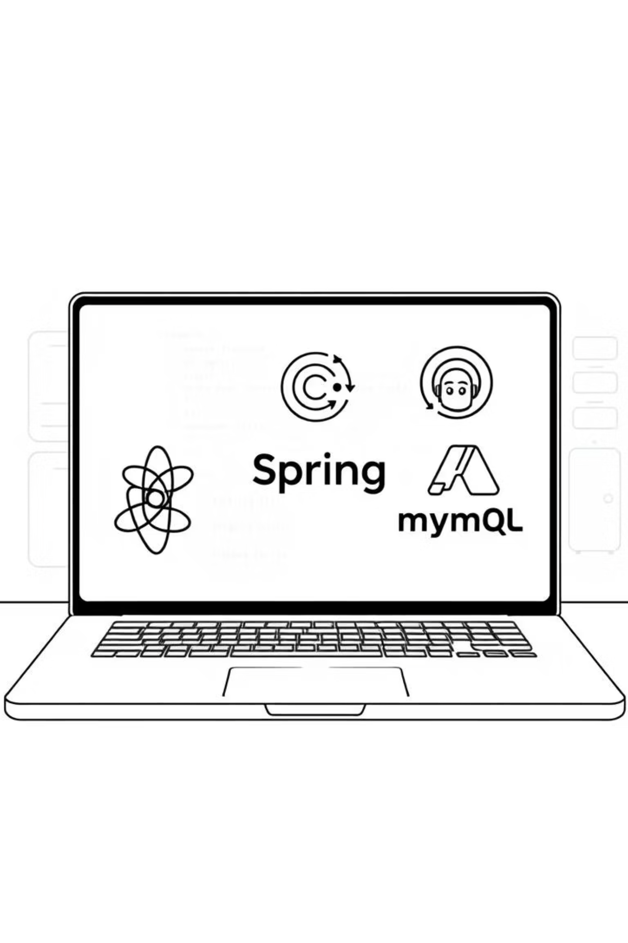
Robust & Scalable Tech Stack
Frontend: ReactJS
Backend: Node.js , AWS
User-friendly, responsive interfaces for customer and staff dashboards.
Secure, high-performance API for all system interactions.
Libraries: Axios (API calls), Redux (state management).
Database: MySQL (relational data, robust).
Tools: Postman (API testing), Git (version control), Docker (containerisation).
Deployment: AWS (scalable cloud infrastructure).

Slide 7





Architecture Diagram
Our microservices architecture ensures modularity, scalability, and resilience.
Customer Interface
QR scan to ReactJS web app.
API Gateway
Routes requests to Spring Boot microservices.
Core Services
Order, menu, and payment processing.
Real-time Notifications
WebSockets for instant updates.
Analytics Database
Aggregates data for owner insights.

Slide 8
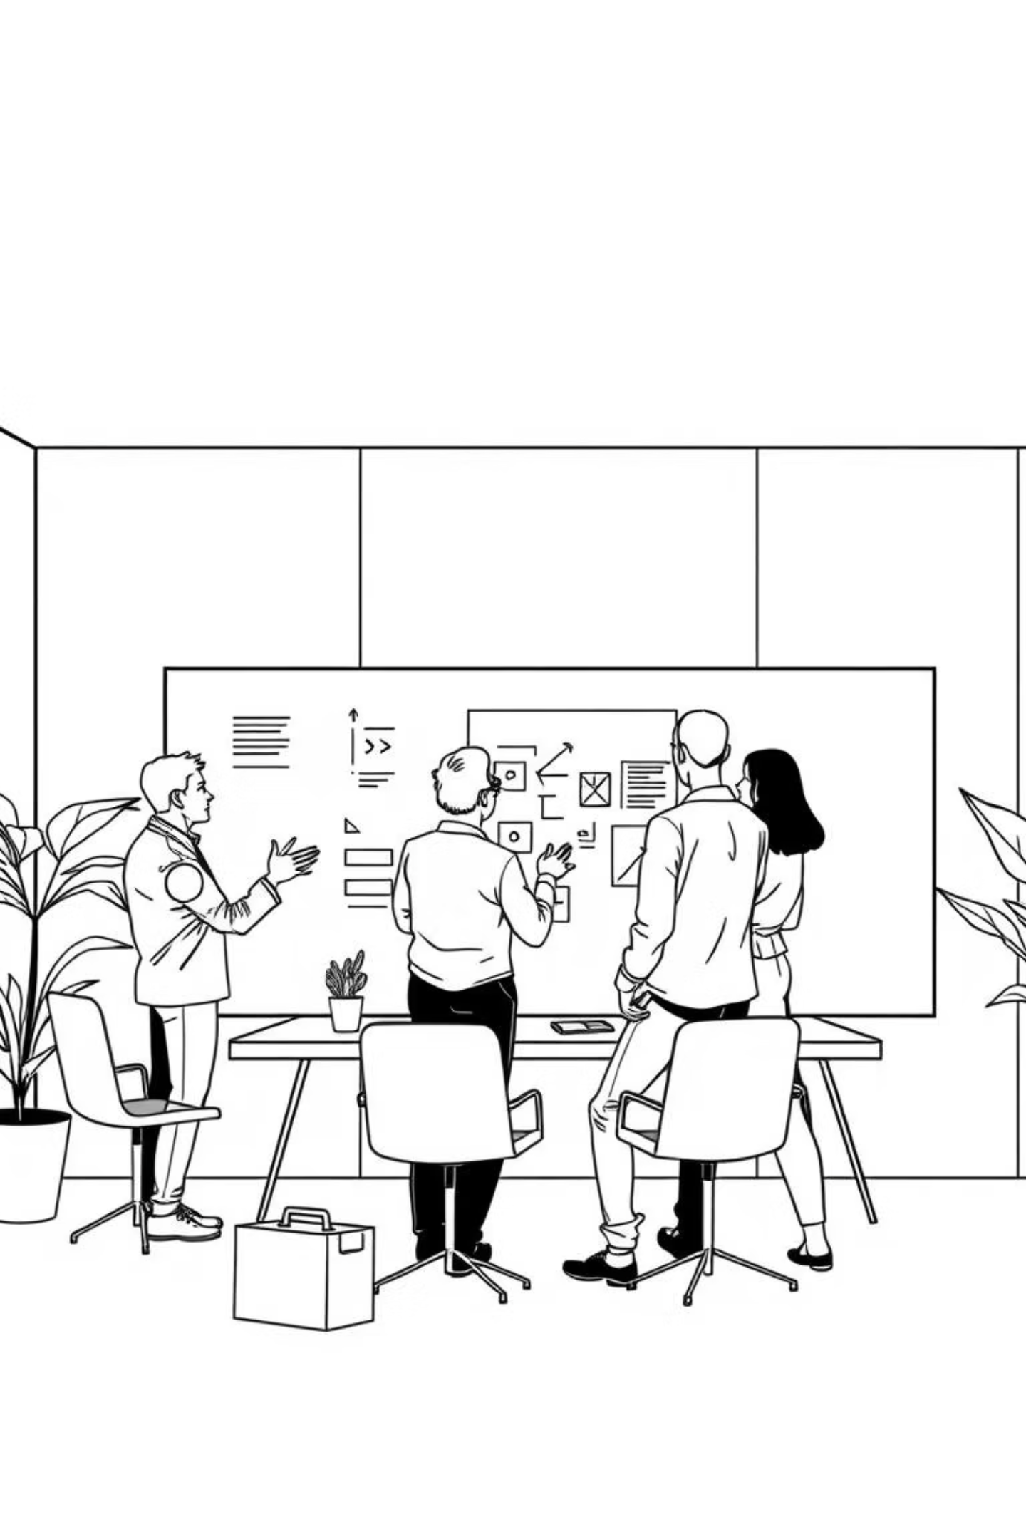
Our Team & Contributions
Sumit Kumar
Lead development for customer & staff UIs.
Cost-cutting: Utilised open-source libraries and AWS free-tier services.

Slide 9












Software Development Lifecycle (SDLC)
We followed an Agile methodology for flexible and iterative development.
Design & Prototyping
Requirement Gathering
Wireframes, mockups, and database schemas.
Customer interviews & market research.
Monitoring & Maintenance
Development Sprints
Continuous feedback and performance optimisation.
Iterative coding and feature implementation.
Deployment
Testing & QA
Staged rollouts to production environment.
Unit, integration, and user acceptance testing.
Tools: Trello for task management.

Slide 10

Impact & Future Outlook
SmartServe is set to transform hospitality, boosting efficiency and customer satisfaction.
Recap: Key Benefits
Future Scope
Increased revenue & efficiency
AI-powered personalisation
Loyalty programme integration
Enhanced customer experience
Integration with POS systems
Data-driven decision making

Slide 11
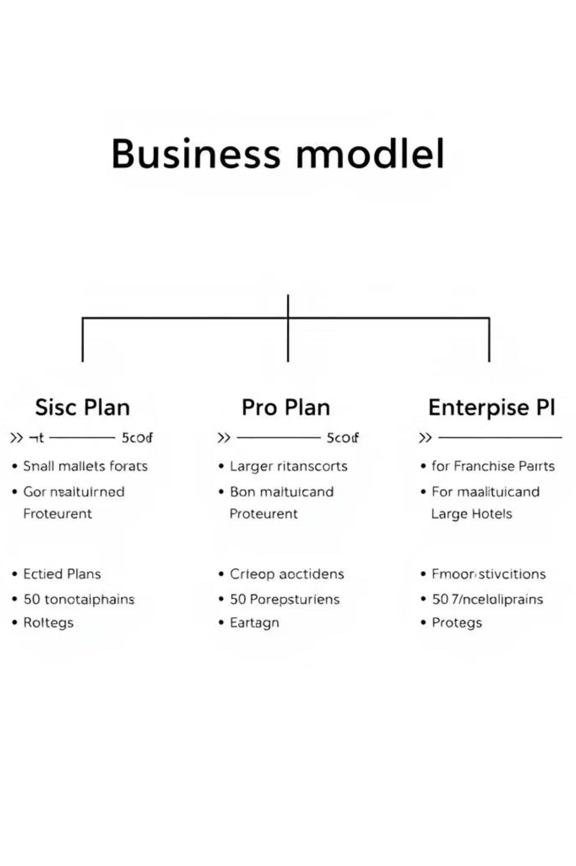
Business Model
Basic Plan: For small, single restaurants. Offers digital menus and ordering.
Pro Plan: For larger restaurants or small hotels. Adds payment integration, service requests, and basic analytics.
Enterprise Plan: For franchises and large hotels. Includes multi-location management, advanced CRM, staff performance metrics, and inventory management.

Slide 12
Thank You!
SmartServe empowers businesses to thrive by streamlining operations, enhancing customer satisfaction, and providing actionable insights.
Enhanced Efficiency
Superior Customer Experience
Data-Driven Growth
Streamlined ordering, payments, and staff workflows.
Real-time analytics for informed decision-making.
Fast, convenient service and dynamic digital menus.
Any Questions?

